Slide 1

Dimensionality reduction Linear discriminant analysis

Slide 2
Contents
Recap of PCA
Difference between PCA and LDA
LDA

Slide 3
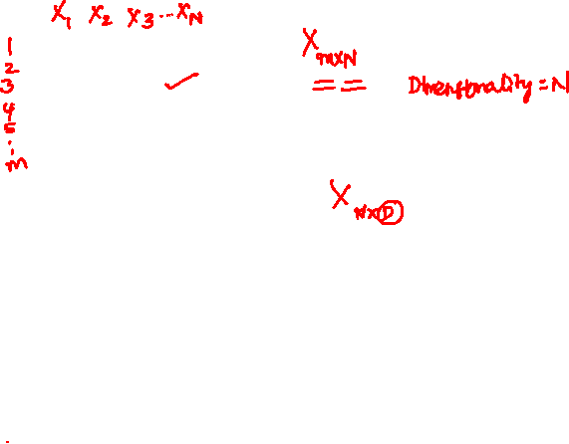
Introduction to dimensionality
Data matrix
Samples (rows)
Columns (attributes)
Or
Samples (cols)
Features (rows)
If the attributes are N and the samples are m
The size of the data matrix is mxN
Dimensionality
Refers to the number of attributes in the data matrix
Sample/Feature | X₁ | X₂ | X₃ | X₄ | Y (Class)
1
2
:
150

Slide 4
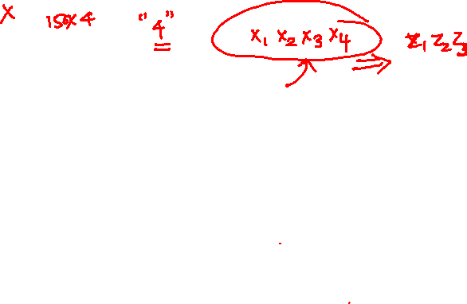

Example
Consider Iris data
We have 4 features, $1$ output variable (3 categories) and 150 samples
Data matrix
Sample/Feature | X₁ | X₂ | X₃ | X₄ | Y (Class)
1
2
:
150

Slide 5
Example
What is the dimensionality of feature space?
Number of attributes or features =4
Dimensionality =4
Sample/Feature | X₁ | X₂ | X₃ | X₄ | Y (Class)
1
2
:
150

Slide 6
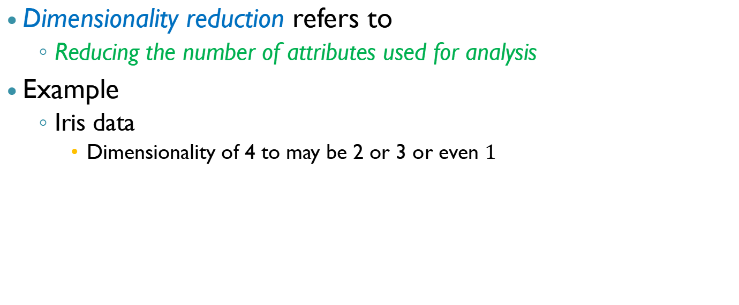
Dimesionality reduction
Dimensionality reduction refers to
Reducing the number of attributes used for analysis
Example
Iris data
Dimensionality of 4 to may be 2 or 3 or even $1$

Slide 7
Dimensionality reduction
Original data
X_{i} = Original attributes
Transfromed data
Z_{i} = Transfromed attributes
Sample/Feature | X₁ | X₂ | .... | X_{N} | Y Class/CV
1
2
:
150
Sample/Feature | Z₁ | Z₂ | .... | Z_{k}
1
2
:
150
k<N

Slide 8
Methods of dimensionality reduction
Feature selection
selecting a few from the existing features
Forward selection (start with none, select each feature and ...)
Backward selection (start with all, reduce one at a time and ...)
Feature extraction
Extract fewer features as transformation/combination of existing features
Focus is on feature extraction methods
What guides these combinations?

Slide 9
Feature extraction
The idea is to obtain the new features from the combination of existing features
Linear combination of attributes
Principle component analysis
Linear discriminant analysis
How do you choose the right combinations (projections or transformations)?

Slide 10
Combinations are chosen based on
Goals of dimensionality reduction and
The data available

Slide 11
Linear transformation-based techniques
Unsupervised learning framework (labels are not available)
The goal is to find the combinations of the variables that reduce the dimensionality and preserve the variance in the data
Example: PCA
Supervised learning framework (labels are available)
The goal is to find the combinations of the variables that reduce the dimensionality and preserve the class separability
Example: LDA

Slide 12
PCA recap
PCA projects the data
into the lower dimensional hyperplane
which preserves the maximum variance in the data
Unsupervised framework
Class labels are not used

Slide 13
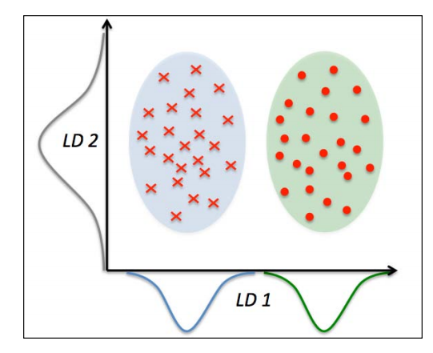
Linear discriminant analysis
LDA
supervised framework
Features along with lables are available
Find the lower dimensional hyperplane, which preserves the maximum class discriminatory information in the data
Project the data onto the hyperplane

Slide 14
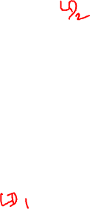
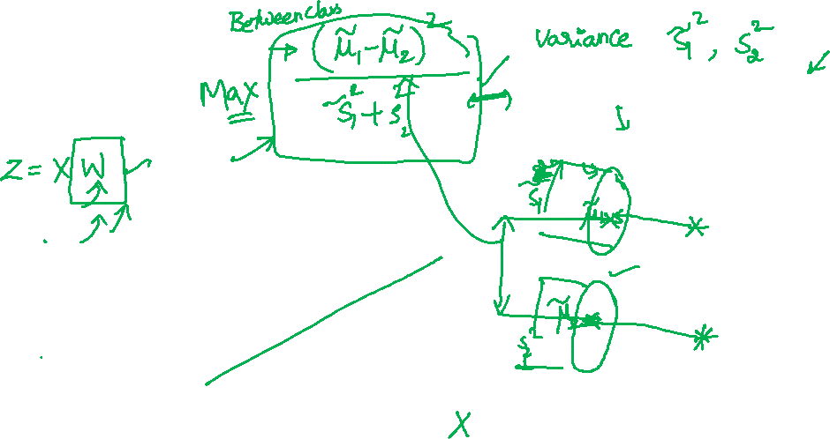
Objective
Good separability because of a good projection
Low separability because of bad projection

Slide 15
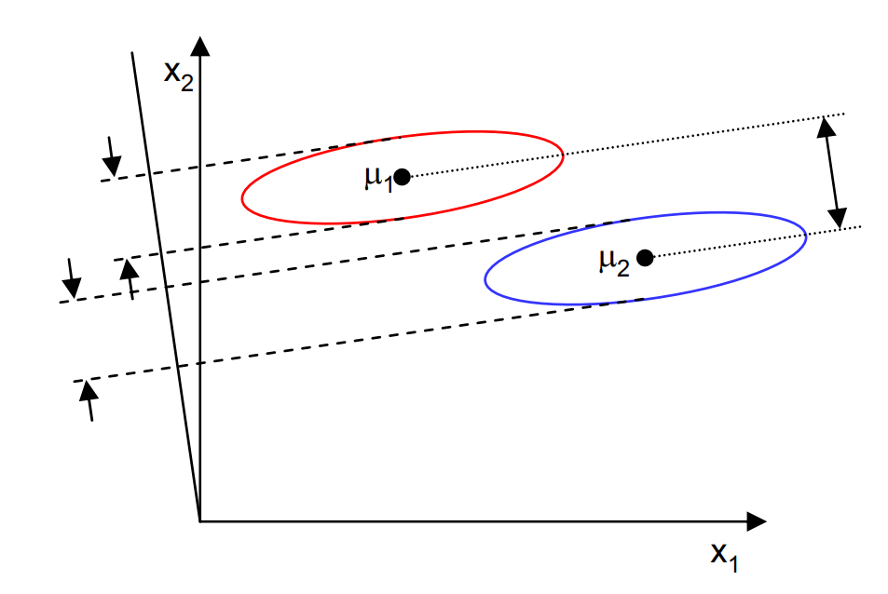
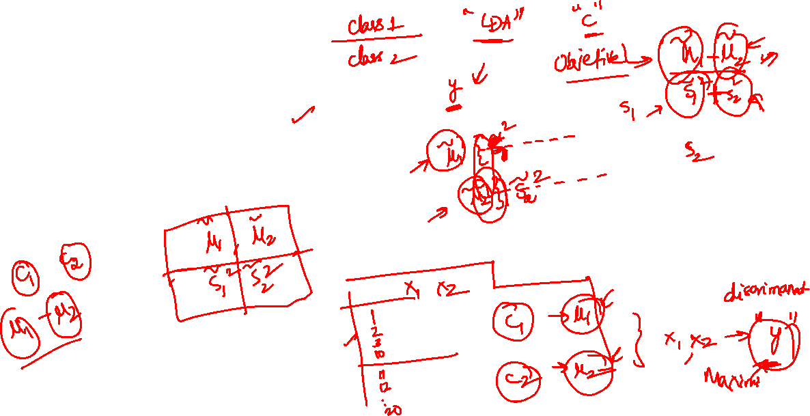
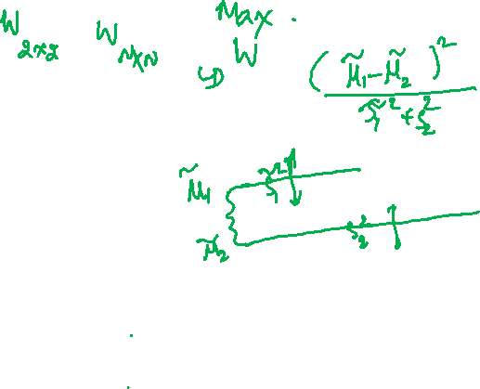
Visual representation of the objective
Assume that we have 2 features and 2 classes
Then the objective of LDA can be pictorially represented as

Slide 16
Intution
Goal: Project the data into lower dimensional hyperplane <=(C-1) dimension which preserves maximum class discriminatory information in the data
Here C is the number of categories or types of classes in the output variable Y
Example: For Iris data, the maximum dimension of lower dimension hyperplane the data can be projected on to is 3D hyperplane
What is the metric for class discriminatory information?
with-in-class scatter matrix
Between class scatter matrix
Given the data, how does one calculate the with-in-class and between class scatter matrices

Slide 17
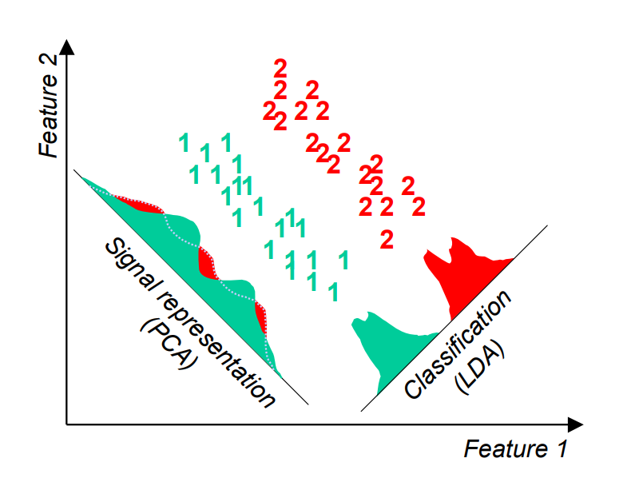
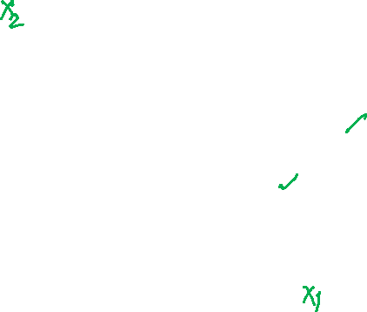
Difference between LDA and PCA: Visual
The objective of LDA is to perform dimensionality reduction
I can do that using PCA
However, we want to preserve as much of the class discriminatory information as possible.
OK, that’s new, let dwell deeper

Slide 18
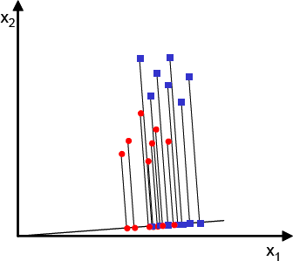
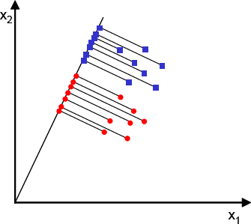
LDA … Two Classes
The two classes are not well separated when projected onto this line
Assume we have m-dimensional samples {x₁, x₂,…, x_{N}}, N₁ of which belong to C₁ and N₂ belong to C₂
We seek to obtain a row vector y by projecting the samples of x onto a line (C-1 space, C=2).
Of all the possible lines we would like to select the one that maximizes the separability of the scalars of different classes
This line succeeded in separating the two classes and in the meantime reducing the dimensionality of our problem from two features (x₁,x₂) to only a scalar value y.

Slide 19
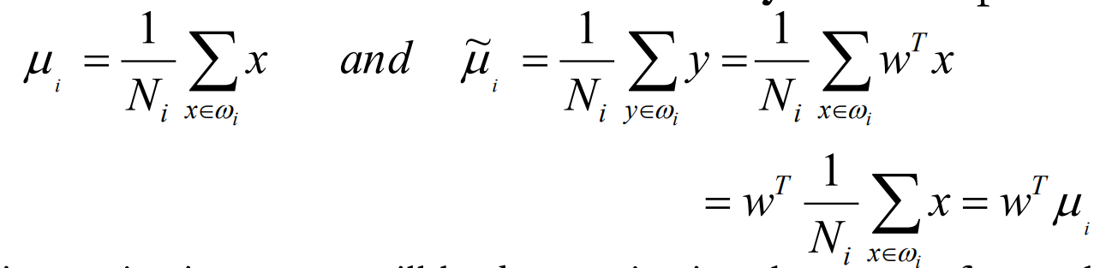

LDA … Two Classes
In order to find a good projection vector, we need to define a measure of separation between the projections.
The mean vector of each class in x and y feature space is:
– i.e. projecting x to y will lead to projecting the mean of x to the mean of y
We could then choose the distance between the projected means as our objective function

Slide 20
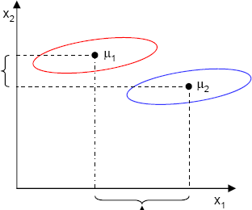
LDA …Two Classes
However, the distance between the projected means is not a very good measure since it does not take into account the standard deviation within the classes.
This axis yields better class separability
This axis has a larger distance between means

Slide 21

LDA … Two Classes
The solution proposed by Fisher is to maximize a function that represents the difference between the means, normalized by a measure of the within-class variability, or the so-called scatter.
For each class we define the scatter, an equivalent of the variance, as (sum of square differences between the projected samples and their class mean).
~ ~
s
2
=
∑
(y − μ )
2
i
i
y∈c_{i}
measures the variability within class $Ci$ after projecting it on the y-space.
Thus ${\tilde{S1}}^{2} + {\tilde{S2}}^{2}$ measures the variability within the two classes at hand after projection, hence it is called within-class scatter of the projected samples

Slide 22
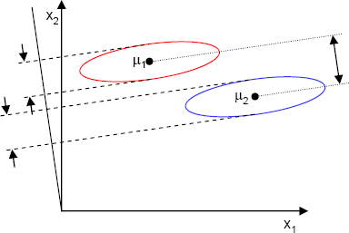
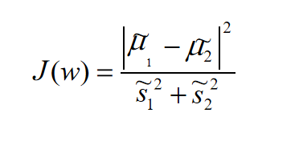
LDA … Two Classes
The Fisher linear discriminant is defined as the linear function w^{T}x that maximizes the criterion function: (the distance between the projected means normalized by the within- class scatter of the projected samples.
Therefore, we will be looking for a projection where examples from the same class are projected very close to each other and, at the same time, the projected means are as farther apart as possible

Slide 23
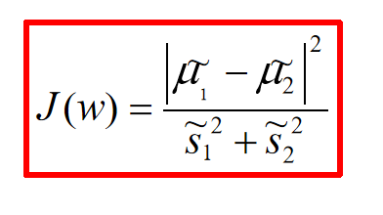
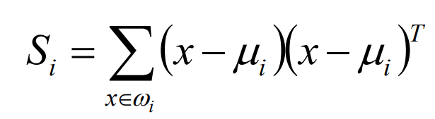

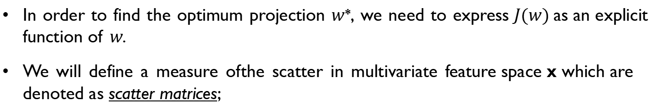
LDA … Two Classes
In order to find the optimum projection $w$*, we need to express $J(w)$as an explicit function of $w$.
We will define a measure of the scatter in multivariate feature space x which are denoted as scatter matrices;
Where $Si$is the covariance matrix of class C$i$, and S_{w} is called the within-class scatter matrix.

Slide 24
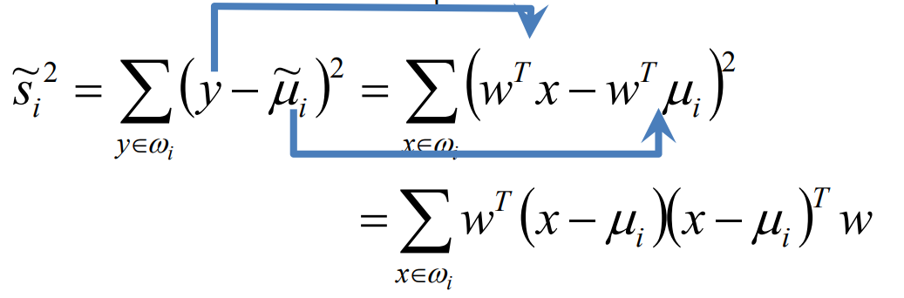
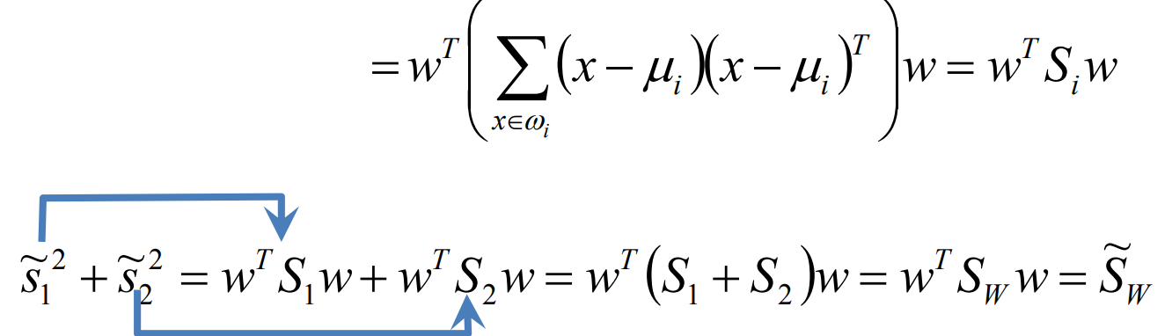

LDA … Two Classes
Now, the scatter of the projection y can then be expressed as a function of the scatter matrix in feature space x.
is the within-class scatter matrix of the projected samples y

Slide 25
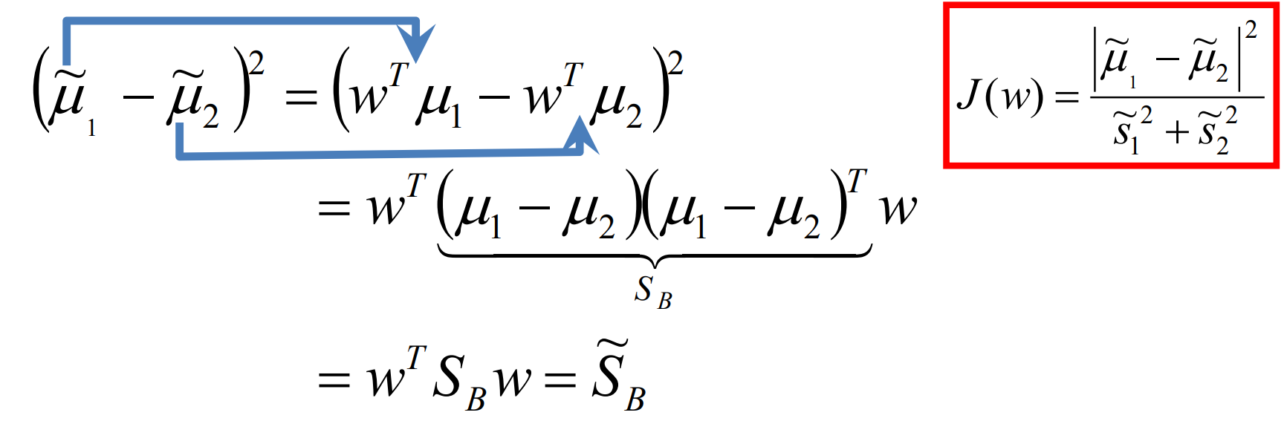











LDA … Two Classes
Similarly, the difference between the projected means (in y-space) can be expressed in terms of the means in the original feature space (x-space).
The matrix S_{B} is called the between-class scatter of the original samples/feature vectors, while $\tilde{SB}$ is the between-class scatter of the projected samples y.
Since S_{B} is the outer product of two vectors, its rank is at most one.

Slide 26
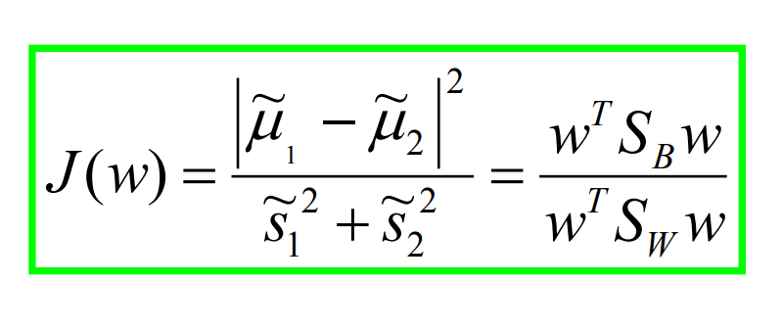



LDA … Two Classes
We can finally express the Fisher criterion in terms of S_{W} and S_{B} as:
Hence J(w) is a measure of the difference between class means (encoded in the between-class scatter matrix) normalized by a measure of the within-class scatter matrix.

Slide 27
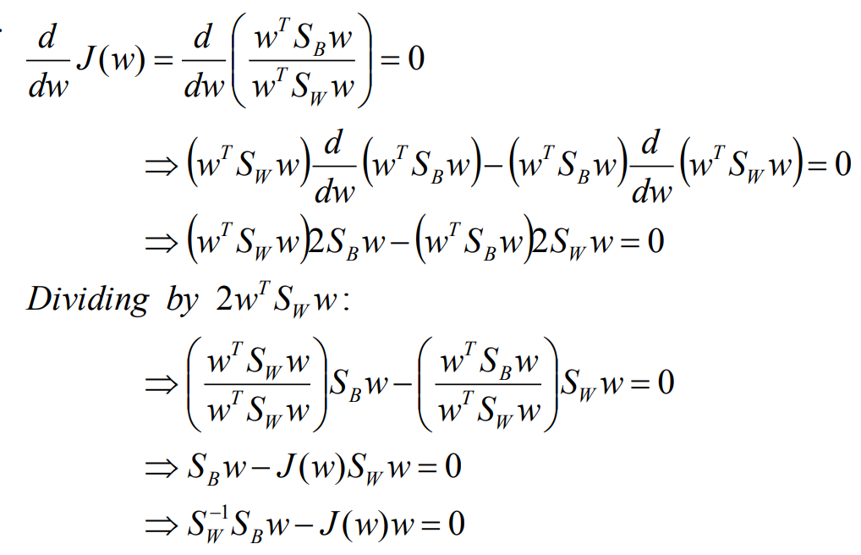
LDA … Two Classes
To find the maximum of $J(w),$we differentiate and equate to zero.

Slide 28
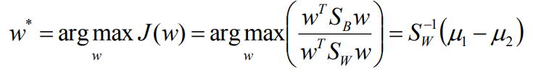
LDA … Two Classes
Solving the generalized eigen value problem
S S w = Αw
Α = J (w) = scalar
−1
where
W B
yields
This is known as Fisher’s Linear Discriminant, although it is not a discriminant but rather a specific choice of direction for the projection of the data down to one dimension.
Using the same notation as PCA, the solution will be the eigen vector(s) of
S = S ⁻¹S
X W B

Slide 29

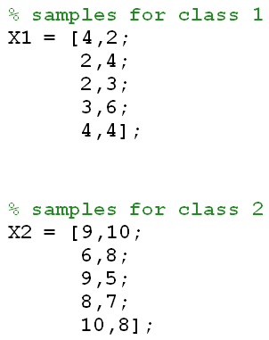
LDA … Two Classes - Example
Compute the Linear Discriminant projection for the following two- dimensional dataset.
– Samples for class ω₁ : X₁=(x₁,x₂)={(4,2),(2,4),(2,3),(3,6),(4,4)}
– Sample for class ω₂ : X₂=(x₁,x₂)={(9,10),(6,8),(9,5),(8,7),(10,8)}
10
9
8
7
6
5
4
3
2
1
0₀
1
2
3
4
5
x₁
6
7
8
9
10

Slide 30
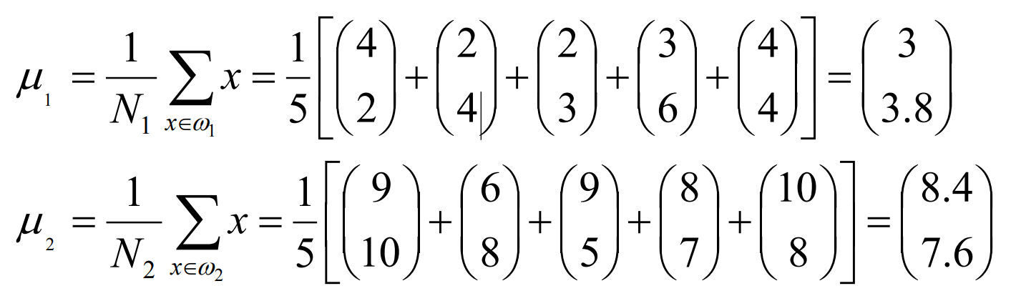

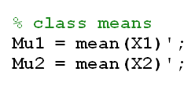
LDA … Two Classes - Example
The classes mean are :

Slide 31
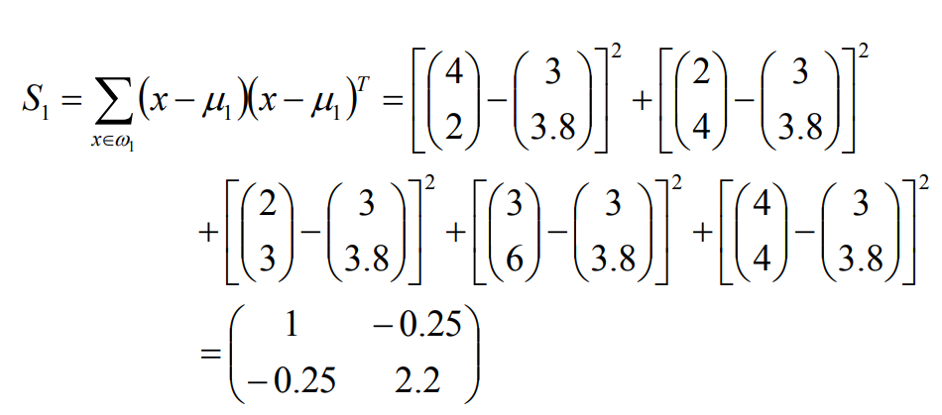


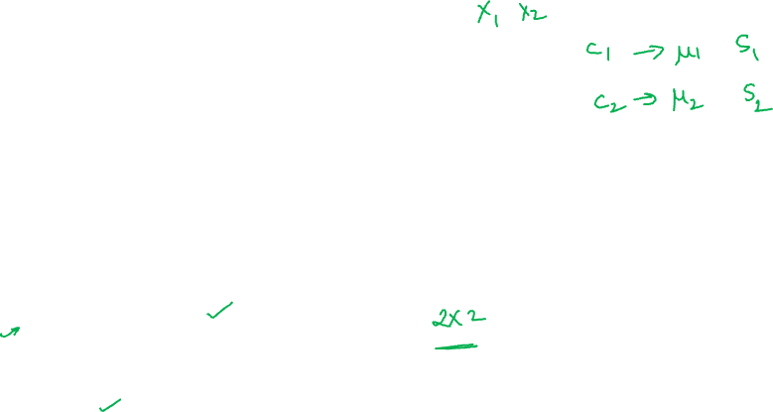
LDA … Two Classes - Example
Covariance matrix of the first class:

Slide 32
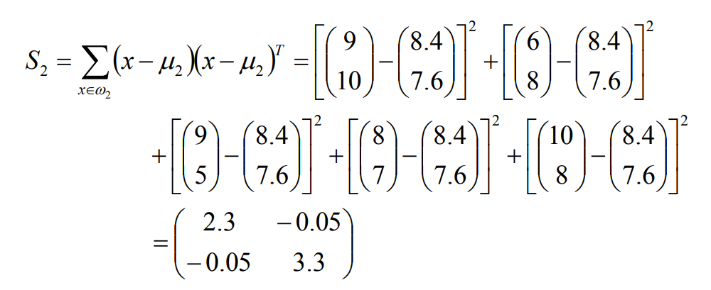



LDA … Two Classes - Example
Covariance matrix of the second class:

Slide 33
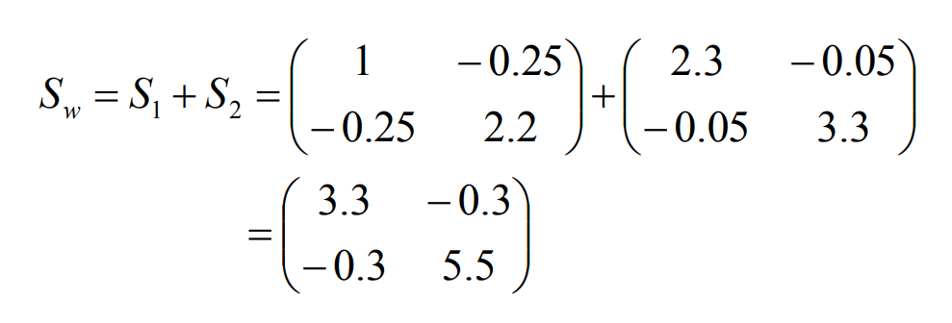



LDA … Two Classes - Example
Within-class scatter matrix:

Slide 34
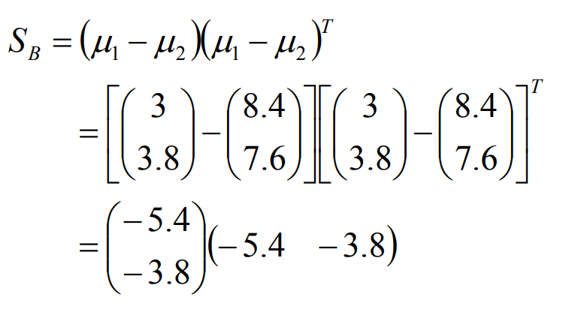
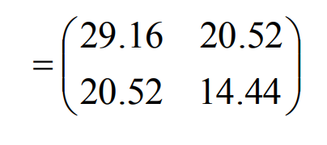


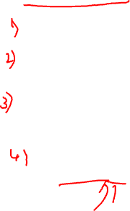

LDA … Two Classes - Example
Between-class scatter matrix:

Slide 35
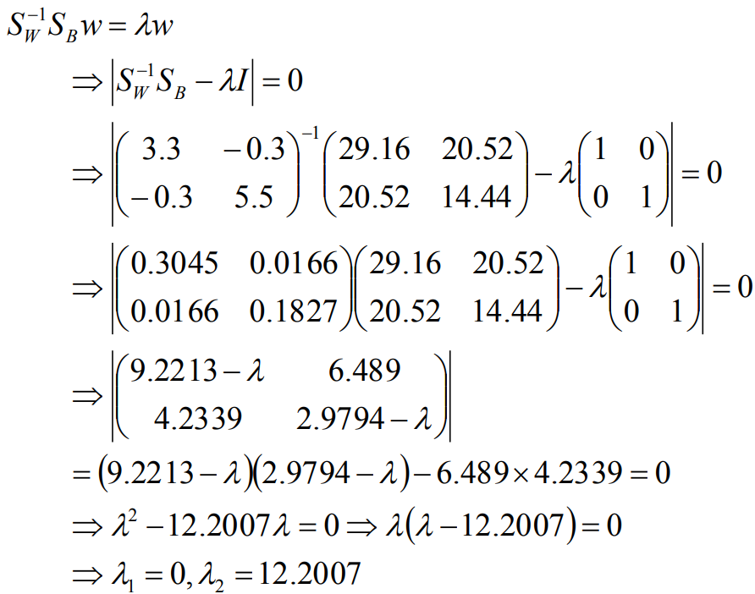

LDA … Two Classes - Example
The LDA projection is then obtained as the solution of the generalized eigen value problem

Slide 36

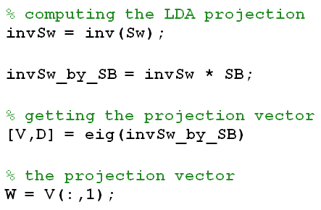
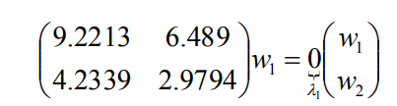
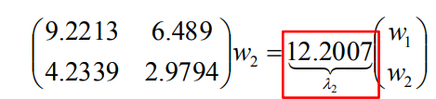
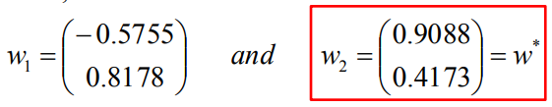
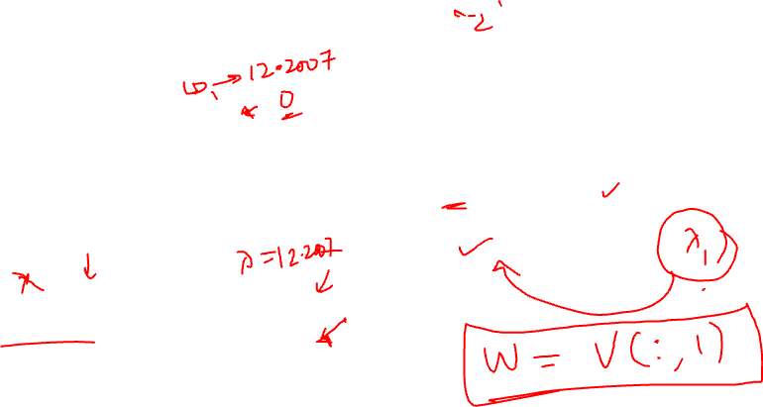
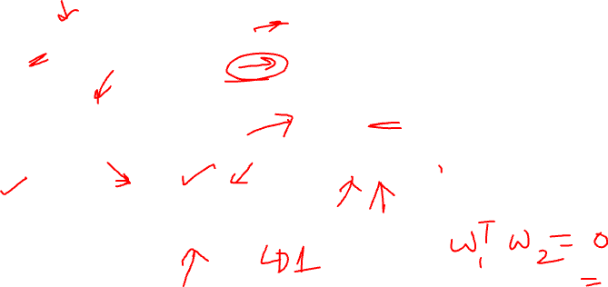
LDA … Two Classes - Example
Hence
and
Thus;
The optimal projection is the one that given maximum$λ = J(w)$

Slide 37
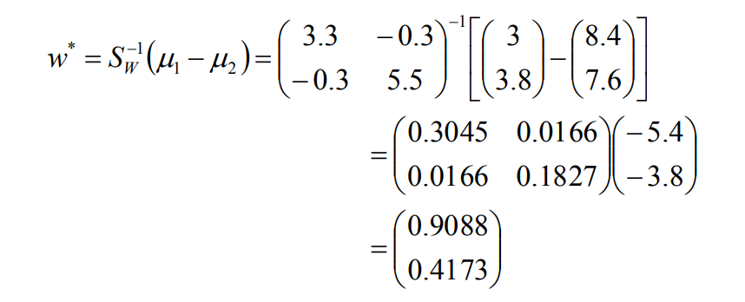
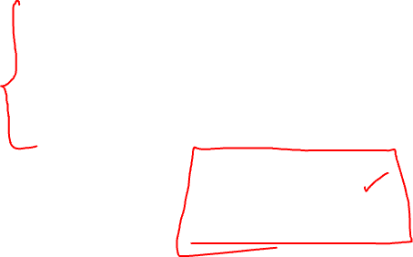
LDA … Two Classes - Example
Or directly;

Slide 38
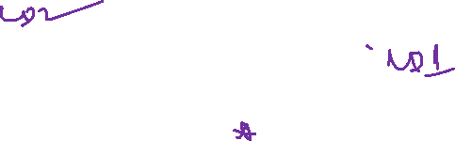
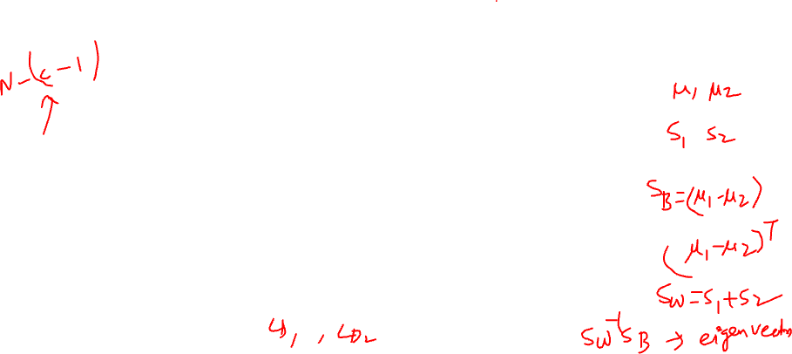
LDAs

Slide 39
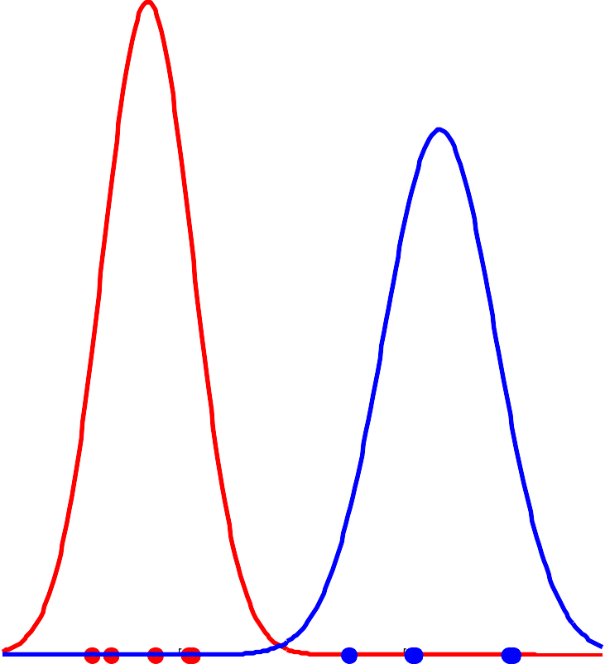
LDA - Projection
Classes PDF : using the LDA projection vector with highest eigen value
0.4
The projection vector corresponding to the highest eigen value
0.35
0.3
0.25
LDA projection vector with the highest eigen value = 12.2007
10
0.2
9
p(y|w )
i
8
0.15
7
0.1
6
0.05
x
2
5
0
0
5
10
15
4
y
3
2
Using this vector leads to good separability between the two classes
1
0
0
1
2
3
4
5
6
x
1
7
8
9
10

Slide 40
LDA - Projection
The projection vector corresponding to the smallest eigenvalue
Classes PDF : using the LDA projection vector with the smallest eigen value
0.35
10
LDA projection vector with the smallest eigen value
0.3
9
0.25
8
0.2
7
p(y|w )
i
6
0.15
x
2
5
0.1
4
3
0.05
2
0
1 2 3 4
y
-4
-3
-2 -1
0
5
6
1
Using this vector leads to bad separability between the two classes
0
-7 -6 -5 -4 -3 -2 -1 0 1 2 3 4 5 6 7 8 9 10
x
1

Slide 41
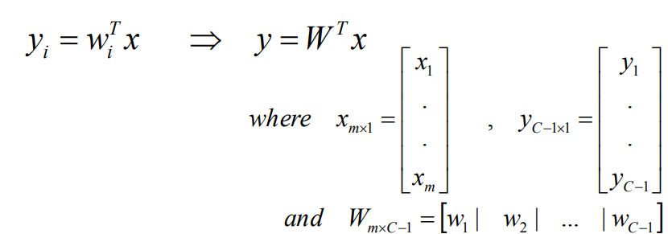



LDA …C-Classes
Now, we have C-classes instead of just two.
We are now seeking (C-1) projections [y₁, y₂, …, y_{C-1}] by means of (C-1) projection vectors $w$_{i}.
$wi$ can be arranged by columns into a projection matrix W = [w₁|w₂|…|w_{C-1}] such that:

Slide 42












LDA – C-Classes
Recall the two classes case, the within-class scatter was computed as:
S_{w} = S₁ + S₂
This can be generalized in the C- classes case as:
Example of two-dimensional features (m = 2), with three
classes C = 3.
µ₁
X₂
µ₃
µ₂
^{S}w2
x₁

Slide 43











LDA – C-Classes
Recall the two classes case, the between- class scatter was computed as:
S_{B} = (μ − μ )(μ − μ )
T
Example of two-dimensional features (m = 2), with three
1 2 1 2
classes C = 3.
For C-classes case, we will measure the between-class scatter with respect to the mean of all classes as follows:
µ
1
x₂
µ₃
µ
µ₂
^{S}w2
x₁

Slide 44


LDA – C-Classes
Similarly,
– We can define the mean vectors for the projected samples y as:
– While the scatter matrices for the projected samples y will be:

Slide 45

LDA –C-Classes
Recall in two-classes case, we have expressed the scatter matrices of the projected samples in terms of those of the original samples as:
~
T
S_{W} = W S
W
~
W
T
S_{B} = W S W
This still hold in C-classes case.
B
Recall that we are looking for a projection that maximizes the ratio of between-class to within-class scatter.
Since the projection is no longer a scalar (it has C-1 dimensions), we then use the determinant of the scatter matrices to obtain a scalar objective function:
~
S_{B}
T
W S_{B}W
J (W ) = =
~
T
S_{W}
W S W
W
And we will seek the projection W* that maximizes this ratio.

Slide 46
LDA – C-Classes
To find the maximum of J(W), we differentiate with respect to W and equate to zero.
Recall in two-classes case, we solved the eigen value problem.
S S w = Αw
where Α = J (w) = scalar
−1
W B
For C-classes case, we have C-1 projection vectors, hence the eigen value problem can be generalized to the C-classes case as:
S S w = Α w
where Α_{i} = J (w_{i} ) = scalar
−1
and i = 1,2,...C −1
W B i i i
Thus, It can be shown that the optimal projection matrix W* is the one whose columns are the eigenvectors corresponding to the largest eigenvalues of the following generalized eigenvalue problem:
S ⁻¹S W * = ΑW *
W B
where Α = J (W * ) = scalar
and W = [
]
*
*
w | w* |
... | w*
1 2
C −1

Slide 47


Limitations of LDA
LDA produces at most C-1 feature projections
If the classification error estimates establish that more features are needed, some other method must be employed to provide those additional features
LDA is a parametric method since it assumes unimodal Gaussian likelihoods
If the distributions are significantly non-Gaussian, the LDA projections will not be able to preserve any complex structure of the data, which may be needed for classification.

Slide 48

Limitations of LDA
LDA will fail when the discriminatory information is not in the mean but rather in the variance of the data

Slide 49



Summary
Compute the N-dimensional mean vectors for the different classes from the dataset.
Compute the scatter matrices (in-between-class and within-class scatter matrix).
Compute the eigenvectors $(e_{1},e_{2},…,e_{N})$and corresponding eigenvalues $(λ1,λ2,…,λd)$for the scatter matrices.
Sort the eigenvectors by decreasing eigenvalues and choose k eigenvectors with the largest eigenvalues to form a N×k dimensional matrix W (where every column represents an eigenvector).
Use this N×k eigenvector matrix to transform the samples onto the new subspace. This can be summarized by the matrix multiplication: $Z=X×W$(where X is a m×n -dimensional matrix representing the m samples, and Z are the transformed m×k -dimensional samples in the new subspace).

Slide 50











Exercise for 3 class problem
$$X_{1}$$ | $$X_{2}$$ | $$Y$$
1 | 1 | 1
2 | 2 | 1
3 | 3 | 1
-2 | 3 | 1
-1 | 4 | 1
1 | 5 | 1
5 | 4 | 2
4 | 5 | 2
3 | 6 | 2
4 | 7 | 2
6 | 6 | 3
8 | 7 | 3
2 | 8 | 3
5 | 9 | 3

Slide 51

THANK YOU

